Slide 1
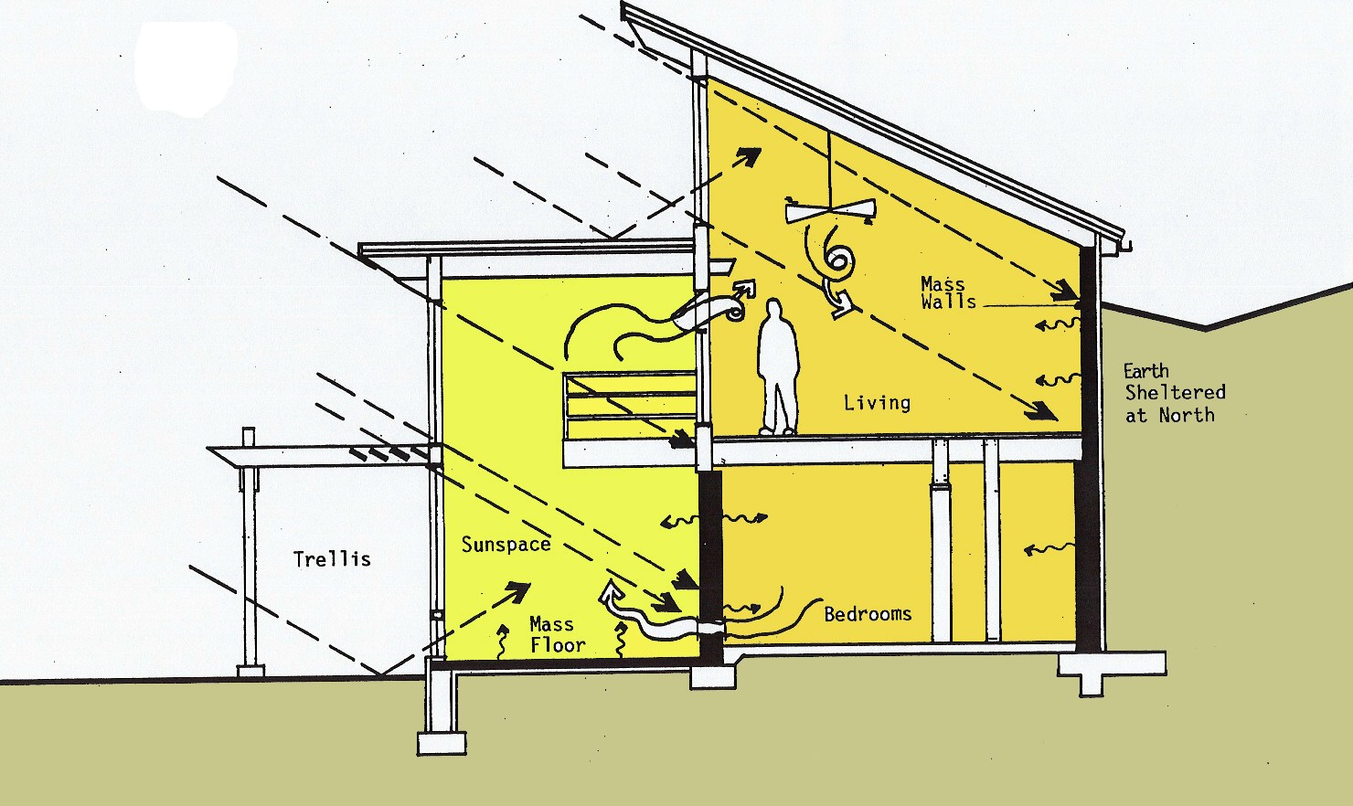
Passive Solar Houses
Heat using the sun with little or no use of other energy sources
www.energysage.com

Slide 2
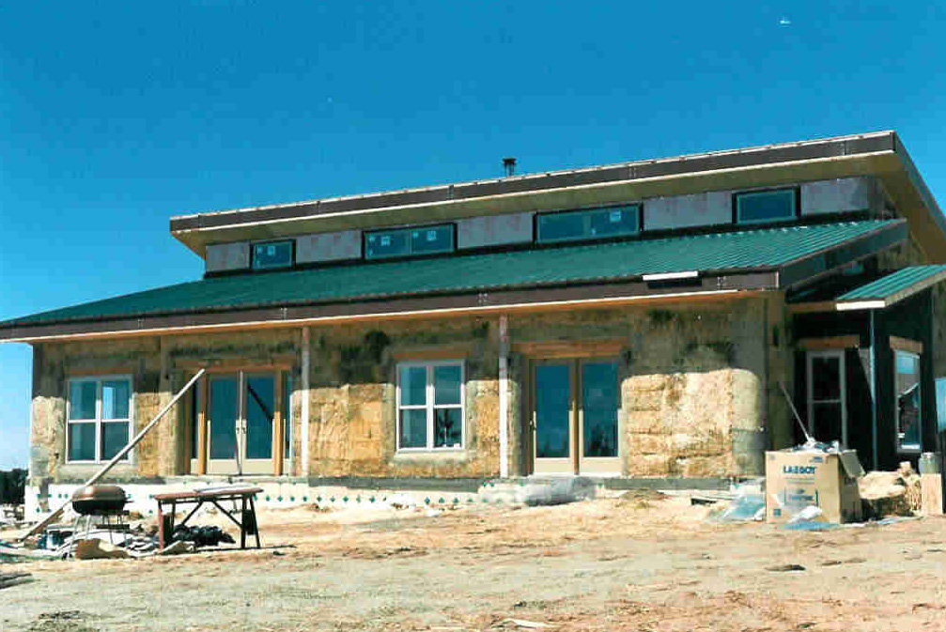
Light Heat Fundamentals
Electromagnetic Radiation
Heat Movement
Heat Storage
www.strawbalehomes.com

Slide 3
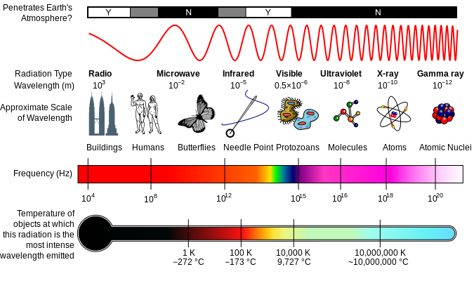
Electromagnetic Radiation
Sun (6000°K) ← Heat Source
Emits: Ultraviolet, visible, & solar-infrared
Objects at room or Earth surface temps
Emit: Infrared
en.wikipedia.org
Notes:
Infrared is heat. Vibrates slower than visible light
http://www.commercialwindows.org/
Long-wave radiation heat transfer refers to radiant heat transfer between objects at room or outdoor environmental temperatures. These temperatures emit radiation in the range of 3–50 microns.
Short-wave radiation heat transfer refers to radiation from the sun (which is at a temperature of 6000K) and occurs in the 0.3–2.5 micron range. This range includes the ultraviolet, visible, and solar-infrared radiation.

Slide 4
Radiation & Adsorption
Sun
Converts thermal energy to EMR
Energy receiver
absorbs EMW and converts to thermal energy
Everything emits & adsorbs EMR
Absorb > emit? get warm
Dark colors absorb more EMW than light colors
Good absorbers are good emitters
Humans absorb EMR from
Lights, fires, warm water or concrete
Notes:
Sun emits electromagnetic waves (EMW)
Thermal mass adsorbs the energy, releasing it as infrared radiation (heat)

Slide 5
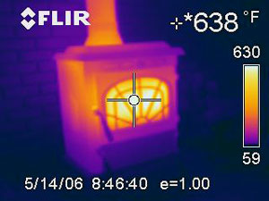
Heat Movement
Radiation (Electromagnetic)
Movement of energy through space without conduction or convection
A hot wood burning stove radiates heats
Conduction
Heat moving thru a solid, molecule to molecule
Molecules stay at original locations
Convection
Warm molecules move
Warm air rises
Forced-air furnace
Notes:
greenpassivesolar.com
Conduction – Conduction is the movement of heat as it travels through solid objects. Heat energy travels as it is transferred from molecule to molecule. The more dense an object, the faster heat moves. Conduction is illustrated in the process that takes place when heat travels from an electrical burner, through a pan, to heat the water inside of the pan.
In passive solar design, heat is absorbed in the building’s thermal mass. The object with thermal mass is usually a dense material like a cement, tile, stone or water. Objects with this ability to conduct heat are usually located in the floor or walls of the building. In the winter, the sun’s is heat energy is absorbed, then spreads through the thermal mass by conduction.
Convection – Convection is the movement of heat circulating through an air (gas) or liquid. Warm molecules rise. Convection is illustrated within a building as warm air rises, the second story of the building will often be warmer than the basement, located at the bottom of a building. Likewise, in a liquid, warmer water will circulate toward the surface. Some passive solar buildings use strategically placed windows or fans to circulate warm and cool currents of air throughout the house.
Radiation – The sun’s radiant heat energy moves through space as an electromagnetic wave. When it strikes a large object like the Earth, the radiant heat is absorbed in the mass of the large object. Although the space that radiant heat travels through can be quite cold, the heat is not absorbed until it hits a dense object. A microwave operates on a similar principle: The contents in the middle of the microwave absorbs the radiant heat and gets hot, while the surrounding air in an of itself does not. When something in the microwave is hot, the heat is coming from the heated object, not from the air.
www.commercialwindows.org
Heat flows through a window assembly in three ways: conduction, convection, and radiation. Conduction is heat traveling through a solid, liquid or gas. Convection is the transfer of heat by the movement of gases or liquids, like warm air rising from a candle flame. Radiation is the movement of energy through space without relying on conduction through the air or by movement of the air, the way you feel the heat of a fire.

Slide 6
Windows & Radiation
Sunlight
Passes easily through untreated glass as shortwave EMW
When adsorbed by thermal mass, emitted as infrared EMW
trapped by double paned windows
gas between panes does not conduct heat well
Notes:
Wikipedia
Objects struck by sunlight absorb the short-wave radiation from the light and reradiate the heat at longer infrared wavelengths. Where there is a material or substance (such as glass) between the sun and the objects struck that is more transparent to the shorter wavelengths than the longer, then when the sun is shining the net result is an increase in temperature — solar gain

Slide 7
Heat Storage
Sensible heat storage
Heating or cooling a liquid or solid
Water, sand, molten salts, rock, concrete
Thermal Mass
Latent heat storage
Phase change materials
Paraffin wax in walls: Cool/solidify at night, keep wall cool as it melts during day
Evapotranspiration of water has cooling effect
Thermo-chemical storage
Chemical reactions
Notes:
Thermal Energy Storage
IEA-ETSAP and IRENA© Technology Brief E17 – January 2013
www.etsap.org – www.irena.org
Water is cheapest (sensible)
Thermal energy storage (TES) is a technology that stocks thermal energy by
heating or cooling a storage medium so that the stored energy can be used at a
later time for heating and cooling applications and power generation. TES systems
are used particularly in buildings and industrial processes. In these applications,
approximately half of the energy consumed is in the form of thermal energy,
the demand for which may vary during any given day and from one day to next.
Therefore, TES systems can help balance energy demand and supply on a daily,
weekly and even seasonal basis. They can also reduce peak demand, energy consumption,
CO2 emissions and costs, while increasing overall effi ciency of energy
systems. Furthermore, the conversion and storage of variable renewable energy
in the form of thermal energy can also help increase the share of renewables in
the energy mix. TES is becoming particularly important for electricity storage in
combination with concentrating solar power (CSP) plants where solar heat can be
stored for electricity production when sunlight is not available.
There are three kinds of TES systems, namely: 1) sensible heat storage that is based
on storing thermal energy by heating or cooling a liquid or solid storage medium
(e.g. water, sand, molten salts, rocks), with water being the cheapest option; 2)
latent heat storage using phase change materials or PCMs (e.g. from a solid state
into a liquid state); and 3) thermo-chemical storage (TCS) using chemical reactions
to store and release thermal energy.
Sensible heat storage is relatively inexpensive compared to PCM and TCS systems
and is applicable to domestic systems, district heating and industrial needs. However,
in general sensible heat storage requires large volumes because of its low
energy density (i.e. three and fi ve times lower than that of PCM and TCS systems,
respectively). Furthermore, sensible heat storage systems require proper design
to discharge thermal energy at constant temperatures. Several developers in Germany,
Slovenia, Japan, Russia and the Netherlands are working on new materials
and techniques for all TES systems, including their integration into building walls
(e.g. by encapsulating phase change materials into plaster or air vents) and transportation
of thermal energy from one place to another. These new applications are
just now being commercialised, and their cost, performance and reliability need
to be verifi ed.
Thermal energy storage systems can be either centralised or distributed systems.
Centralised applications can be used in district heating or cooling systems, large
industrial plants, combined heat and power plants, or in renewable power plants
(e.g. CSP plants). Distributed systems are mostly applied in domestic or commer-
2 Thermal Energy Storage | Technology Br ief
cial buildings to capture solar energy for water and space heating or cooling. In
both cases, TES systems may reduce energy demand at peak times.
A TES system’s economic performance depends substantially on its specifi c application
and operational needs, including the number and frequency of storage
cycles. In general, PCM and TCS systems are more expensive than sensible heat
systems and are economically viable only for applications with a high number of
cycles. In mature economies (e.g. OECD countries), a major constraint for TES
deployment is the low construction rate of new buildings, while in emerging
economies TES systems have a larger deployment potential.
Support for research and development (R&D) of new storage materials, as well
as policy measures and investment incentives for TES integration in buildings,
industrial applications and variable renewable power generation is essential to
foster its deployment. R&D eff orts are particularly important with regards to PCM
and TCS systems.

Slide 8
Passive Solar Principles
Orient house to sun
Collect east, south, and west sunlight in winter
Design for all 12 months
Sun position
Clouds – seasonal?
Wind – seasonal?
Surrounding features
Deciduous trees: shade in summer (east, west, south)
Evergreens to North side for wind break
Kachadorian, J (2006) “The Passive Solar House” Chelsea Green Publishing Company, White River Junction, VT.
Notes:
http://answers.yahoo.com/
Light energy and heat energy are the same thing, 'electromagnetic waves'. The fancy name for heat energy is infrared radiation and the fancy name for light energy is visible radiation. But they work the same. Heat and light come in tiny packets called photons that work like particles in some ways. They also act like waves, vibrating back and forth very fast. A photon is a unit, a whole package. There is no such thing as fast photons or slow photons. They are all going the same speed, the speed of light. So when photons hit something (like sunlight shining on your face) they can't slow down. They have to give up some of their energy in a different way. So they have to vibrate at a different rate of speed. They still move at the speed of light, they just vibrate slower while they move. So, the ONLY difference between heat and light is that they are vibrating at different rates of speed, even though they are travelling at the same rate of speed. Otherwise, they are just the same. Infrared (heat) photons vibrate slower than visible (light) photons. The light photons hit your face and are absorbed (swallowed up) by atoms. Their rate of vibration slows down and they change to heat photons. Your face feels warm. Then the heat photons leak out again as you cool off. Now, the Sun does put out a lot of both heat and light. Have you ever been in a car in the wintetime, with the sun shining in your face? The windows are transparent to light but not to heat. It is cold outside. Infrared waves (the photons) do not go through glass well. They are reflected outside. But the light comes through because the window is transparent to light, it lets the waves (phtotons) through. The light turns into heat when it hits your face, and you feel it. This is also what makes a car so hot in the summertime: the light of the sun comes in the car and changes to heat. Then it can't get out the windows again, and the car gets hot. So we do two things: we leave the windows open a little to let the air circulate and carry the heat back outside, and we put reflectors inside the windshield, to reflect the light back out, If the light is not absorbed, it is not being turned into heat. I hope this helps.

Slide 9
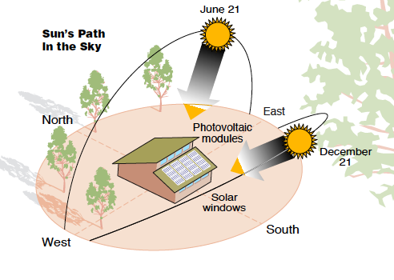
Sun Location
Dec 17, 2007 - June 21, 2008
Clifton Suspension Bridge, Bristol, UK
Pin Hole Camera
Justin Quinnell
greenpassivesolar.com
http://greenpassivesolar.com/

Slide 10
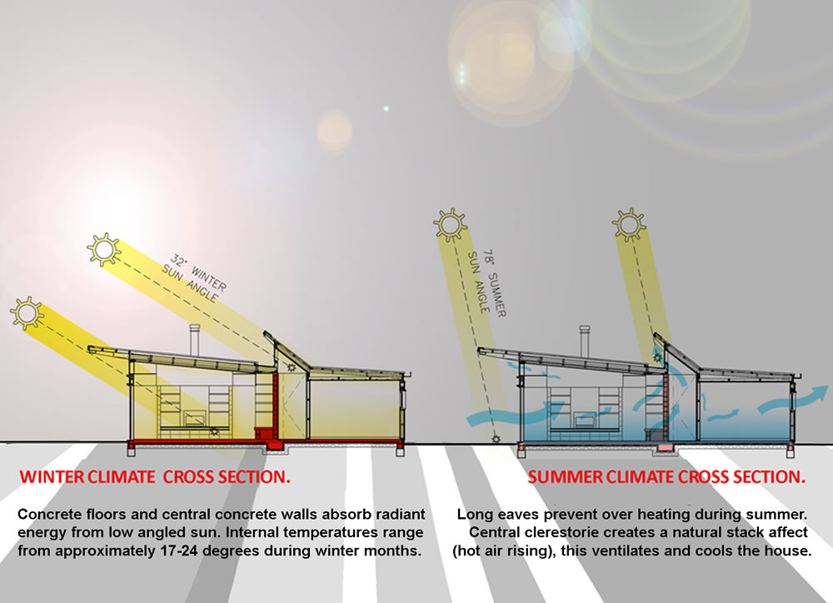
Winter & Summer Sun
www.homeworld.co.nz

Slide 11
Heating Season
Orientation: Long axis facing south
Glazing
South windows let in sunlight in winter
Thermal shutters for insulation at night in Winter
External fixed summer shading
Thermal mass
Tile-covered slab floors, masonry walls, & water-filled containers
Heat distribution
Openings and room layouts move solar heated air to other rooms
Other
Effective insulation, airtight construction, efficient HVAC systems
Notes:
Affordable Passive Solar Planbook for NC State Energy Office, N.C. Department of Administration, Appalachian State University Energy Center, Boone, North Carolina, June 2005

Slide 12
Cooling Season
Window shading
Overhangs, shutters, blinds, shade screens, curtains, landscaping shade
Ventilation
Natural breezes through windows on opposite sides of the house, ceiling fans, whole house fans, and space fans
Thermal Mass
Absorbs heat during day
Other
Effective insulation, airtight construction, efficient HVAC systems
Notes:
Affordable Passive Solar Planbook for NC State Energy Office, N.C. Department of Administration, Appalachian State University Energy Center, Boone, North Carolina, June 2005

Slide 13
Room Layout
Frequently-used rooms, morning to bedtime (Family rooms, kitchens, & dens)
South side
Day-use rooms (breakfast rooms, sunrooms, playrooms, & offices)
South side or by frequently-used rooms (solar heating)
Sunspaces
Isolate from house if unconditioned (best), provide shade in Summertime
Winter
Daytime-open doors to let in heat
Nighttime-close doors to buffers against cold
Privacy rooms (bathrooms & dressing rooms)
Can be connected to solar-heated areas, but not usually located on south side
Notes:
Affordable Passive Solar Planbook for NC State Energy Office, N.C. Department of Administration, Appalachian State University Energy Center, Boone, North Carolina, June 2005
Frequently-used rooms (morning to bedtime)- Family rooms, kitchens, and dens work well on the south side. Be aware of potential problems with glare from sunlight through large expanses of windows.
❖ Day-use rooms- Breakfast rooms, sunrooms, playrooms, and offices work well on the south side of the house. They should adjoin rooms that are used frequently to take full advantage of solar heating.
❖ Sunspaces- These rooms can be isolated from the house if unconditioned. In winter, the doors can be opened to let solar heat move into the home. At night, the doors can be closed, and the sunspace buffers the home against the cold night air. In summer, sunspaces protect the home from outside heat gain. For best performance, they should not be air conditioned.
❖ Privacy rooms- Bathrooms and dressing rooms can be connected to solar-heated areas, but are not usually located on the south side.
❖ Night-use rooms- Bedrooms are usually best on the north side, unless used often during the day. It is often difficult to fit thermal storage mass into bedrooms, and privacy needs may limit opportunities for installing large glass areas. However, some homeowners may prefer bedrooms filled with natural light and can use passive solar features effectively.
❖ Seldom-used rooms- Formal living rooms, dining rooms, and extra bedrooms are best on the north side, out of the traffic pattern and air flow.
❖ Buffer rooms- Unheated spaces such as closets, laundries, workshops, pantries, and garages work best against the north, east, or west exterior walls. They protect the conditioned space from outside temperature extremes.
❖ Exterior covered areas- Porches and carports on the east and west provide summer shading. However, west-facing porches may be uncomfortable in the afternoon. Avoid covered porches on the south side, as they shade winter sunlight.

Slide 14
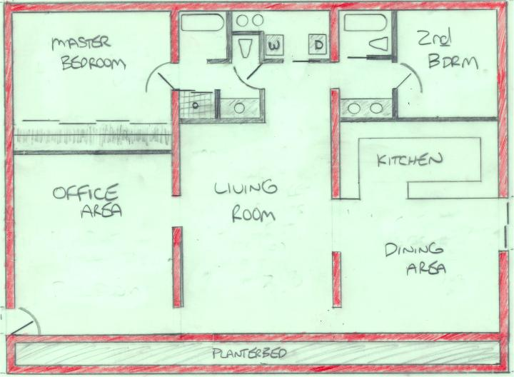
Room Layout (cont.)
www.thenaturalhome.com
Shading Porch
Shading Porch
Night Time Room
Night Time Room
Activity Rooms
South Side

Slide 15
Room Layout (cont.)
Night-use rooms (bedrooms, unless used during day)
North side
Seldom-used rooms (formal living rooms, dining rooms, & guest bedrooms)
North side, out of traffic and air flow.
Buffer rooms, unheated (closets, laundries, workshops, pantries, & garages)
North, east, or west exterior walls
Exterior covered areas (porches and carports)
East and west side provide summer shading.
Uncomfortable in morning (east) or afternoon (West)
Avoid on south side, shade winter sunlight

Slide 16
Solar Principles (cont.)
Provide Effective Thermal Mass
Night time heat in Winter
Day time cooling in Summer
Insulate and seal
Vapor barriers
Air-lock entrance
Night time insulation for windows
Windows for solar collection & cooling
Let in sun for heat, open for cooling
Kachadorian, J (2006) “The Passive Solar House” Chelsea Green Publishing Company, White River Junction, VT.
Notes:
http://answers.yahoo.com/
Light energy and heat energy are the same thing, 'electromagnetic waves'. The fancy name for heat energy is infrared radiation and the fancy name for light energy is visible radiation. But they work the same. Heat and light come in tiny packets called photons that work like particles in some ways. They also act like waves, vibrating back and forth very fast. A photon is a unit, a whole package. There is no such thing as fast photons or slow photons. They are all going the same speed, the speed of light. So when photons hit something (like sunlight shining on your face) they can't slow down. They have to give up some of their energy in a different way. So they have to vibrate at a different rate of speed. They still move at the speed of light, they just vibrate slower while they move. So, the ONLY difference between heat and light is that they are vibrating at different rates of speed, even though they are travelling at the same rate of speed. Otherwise, they are just the same. Infrared (heat) photons vibrate slower than visible (light) photons. The light photons hit your face and are absorbed (swallowed up) by atoms. Their rate of vibration slows down and they change to heat photons. Your face feels warm. Then the heat photons leak out again as you cool off. Now, the Sun does put out a lot of both heat and light. Have you ever been in a car in the wintetime, with the sun shining in your face? The windows are transparent to light but not to heat. It is cold outside. Infrared waves (the photons) do not go through glass well. They are reflected outside. But the light comes through because the window is transparent to light, it lets the waves (phtotons) through. The light turns into heat when it hits your face, and you feel it. This is also what makes a car so hot in the summertime: the light of the sun comes in the car and changes to heat. Then it can't get out the windows again, and the car gets hot. So we do two things: we leave the windows open a little to let the air circulate and carry the heat back outside, and we put reflectors inside the windshield, to reflect the light back out, If the light is not absorbed, it is not being turned into heat. I hope this helps.

Slide 17
Thermal Mass
Thermal mass heated by warmer objects (sun, lights, people, wood stove,…)
Heat conducts from warmed surface of thermal mass to cooler interior
Thermal mass radiates heat to cooler objects
Warmer interior of thermal mass conducts to cooler surface
This must occur within daily cycle of building
Haglund, B and K Rathmann “THERMAL MASS IN PASSIVE SOLAR AND ENERGY-CONSERVING BUILDINGS”
Notes:
THERMAL MASS IN PASSIVE SOLAR AND
ENERGY-CONSERVING BUILDINGS
Bruce Haglund
Professor, University of Idaho
Kurt Rathmann
Research Assistant, University of Idaho
Heat flows from warmer to cooler objects by radiation, conduction & convection

Slide 18
Types of Solar Heating
Indirect Gain
Sunlight strikes thermal storage unit
Isolated Gain
Sunlight strikes separate space
Direct Gain
Sunlight strikes space to be heated
Notes:
Affordable Passive Solar Planbook for NC State Energy Office, N.C. Department of Administration, Appalachian State University Energy Center, Boone, North Carolina, June 2005

Slide 19
Indirect Gain, Trombe Wall
Thermal Mass
Notes:
Affordable Passive Solar Planbook for NC State Energy Office, N.C. Department of Administration, Appalachian State University Energy Center, Boone, North Carolina, June 2005
Thermal storage walls, also know as Trombe wall, require construction of two exterior walls – one made of concrete or concrete-filled block and the other made of glass, are more expensive than other passive solar designs. Thermal storage walls store solar heat and let it radiate into the living area. They also do not provide as much savings on heating bills during the cloudy winters.

Slide 20
Isolated Gain, Sun Space
Notes:
Affordable Passive Solar Planbook for NC State Energy Office, N.C. Department of Administration, Appalachian State University Energy Center, Boone, North Carolina, June 2005
Sunspaces, rooms independent of the home’s heating and cooling system, capture the sun’s energy and transfer the heat generated to the house. Sunspaces are also used often but are usually not connected to the central heating and cooling system of the rest of the home. They are comfortable during much of the year, but are not intended as living space year round.

Slide 21
Isolated Gain, Air Collector
Notes:
Affordable Passive Solar Planbook for NC State Energy Office, N.C. Department of Administration, Appalachian State University Energy Center, Boone, North Carolina, June 2005
Sunspaces, rooms independent of the home’s heating and cooling system, capture the sun’s energy and transfer the heat generated to the house. Sunspaces are also used often but are usually not connected to the central heating and cooling system of the rest of the home. They are comfortable during much of the year, but are not intended as living space year round.

Slide 22
Direct Gain
T M
Thermal Mass
Usually the best option
Notes:
Affordable Passive Solar Planbook for NC State Energy Office, N.C. Department of Administration, Appalachian State University Energy Center, Boone, North Carolina, June 2005
Direct gain system, the most common and simple designs, are houses in which the living areas themselves act as collectors of solar energy by using south-facing windows which allow sunlight directly enter the home. Thermal mass in the form of concrete or masonry walls or floors capture

Slide 23
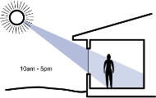
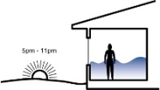
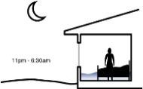
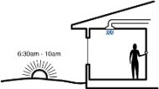
A Day in the life
10 AM to 5 PM
Sun warms south facing rooms & thermal mass
5 PM to 11 PM
Thermal mass keeps house warm
11 PM to 6:30 AM
House stays warm enough for sleeping under covers
6:30 to 10 AM
Efficient supplemental heat needed
www.southface.org
Notes:
http://www.southface.org/learning-center/library/solar-resources/how-passive-solar-works
10:00 am to 5:00 pm
Sunlight enters south-facing windows and strikes the thermal mass inside the home. The sunlight is converted to heat energy, which heats both the air and thermal mass materials. On most sunny days, solar heat maintains comfort during the mid-morning to late afternoon periods.
5:00 pm to 11:00 pm
As the sun sets, it stops supplying heat to the home. However, a substantial amount of heat has been stored in the thermal mass. These materials release the heat slowly into the passive solar rooms, keeping them comfortable on most winter evenings. If temperatures fall below the comfort level, supplemental heat is needed.
11:00 pm to 6:30 am
The home owner sets the thermostat back at night, so less backup heating is needed. Energy-efficient features in the home minimize heat losses to the outside.
6:30 am to 10:00 am
Providing a comfortable temperature with passive solar heating systems is toughest in the cool early morning hours. The thermal mass has usually given up most of its heat, and the sun has not risen enough to begin heating the home. During this period, the home owner may have to rely on supplemental heat. Energy-efficient features in the home minimize the need for supplemental heating.

Slide 24
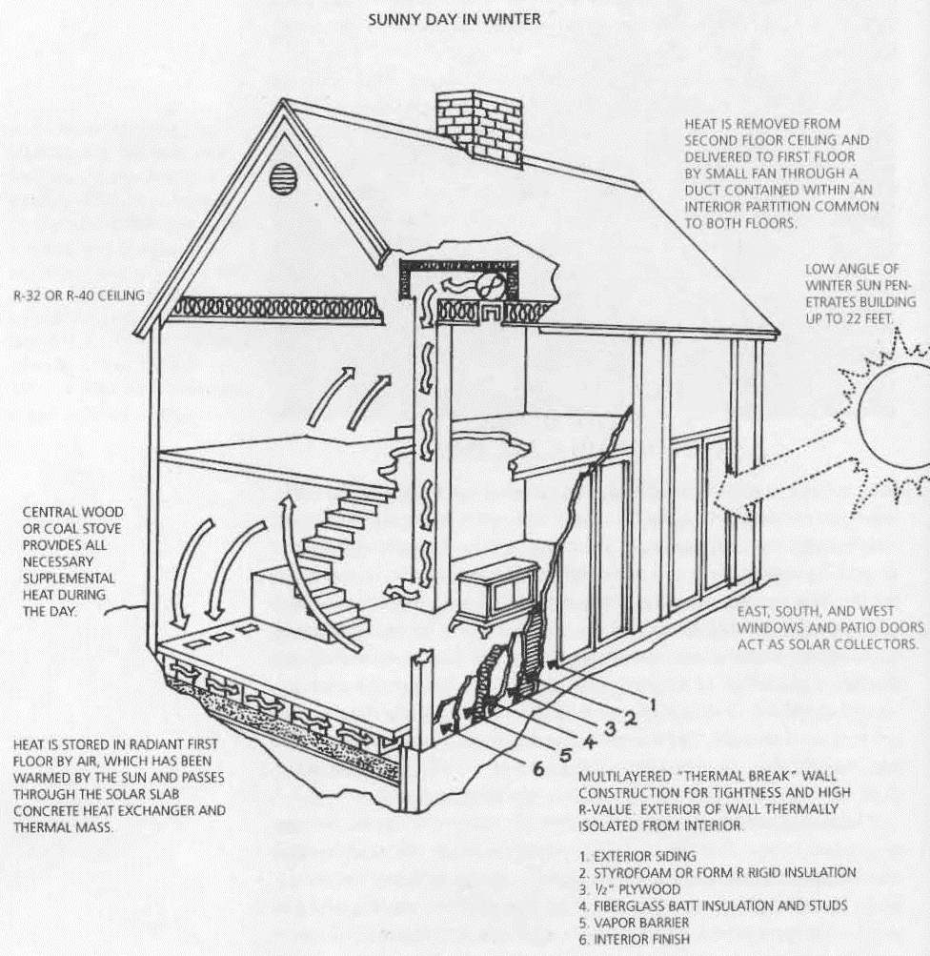
Sunny Day in Winter
Kachadorian, J (2006) “The Passive Solar House” Chelsea Green Publishing Company, White River Junction, VT.

Slide 25
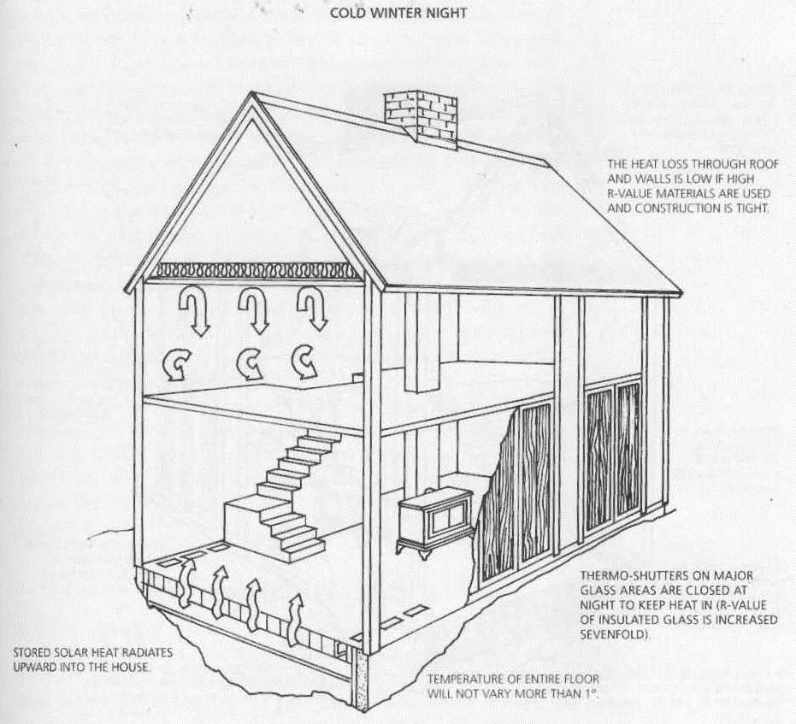
Cold Winter Night
Kachadorian, J (2006) “The Passive Solar House” Chelsea Green Publishing Company, White River Junction, VT.

Slide 26
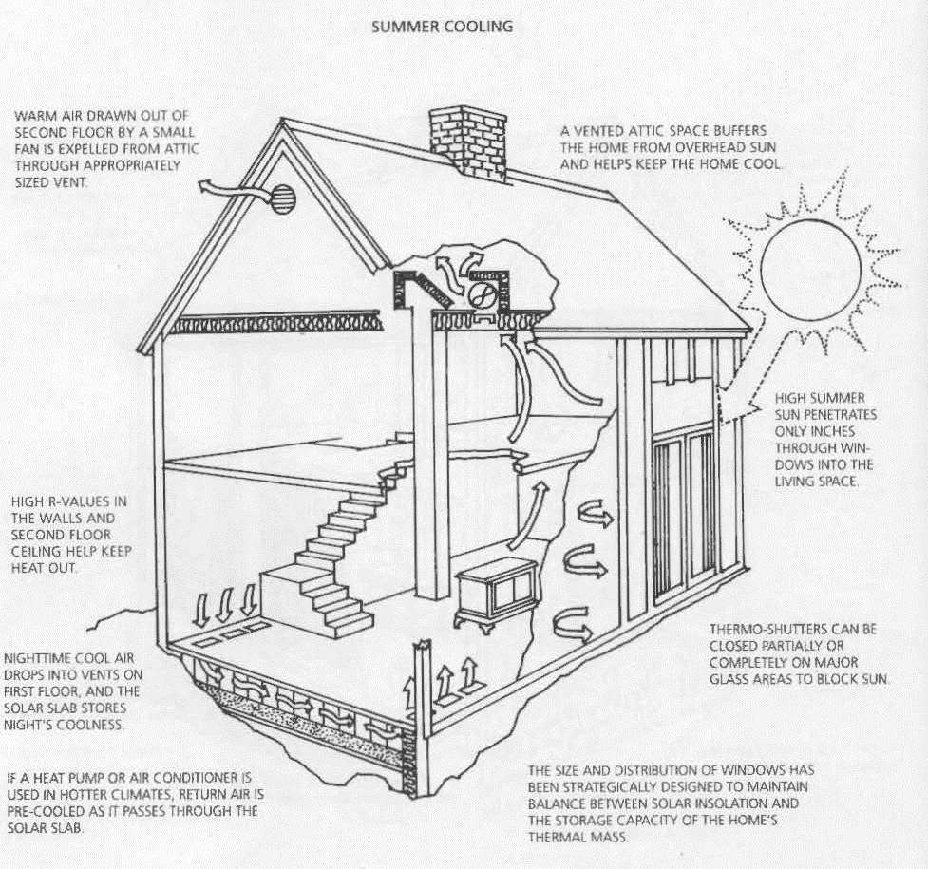
Summer Cooling
Kachadorian, J (2006) “The Passive Solar House” Chelsea Green Publishing Company, White River Junction, VT.

Slide 27
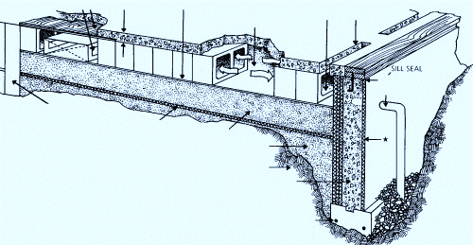
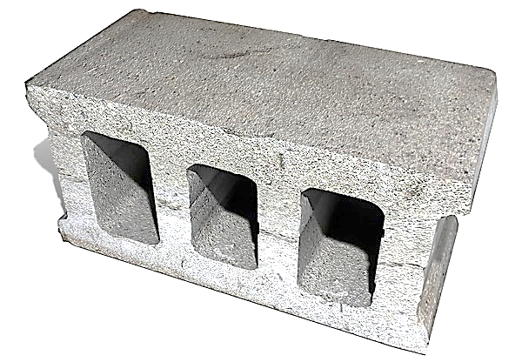
Concrete Block Slab
www.ourcoolhouse.com
www.turbosquid.com

Slide 28
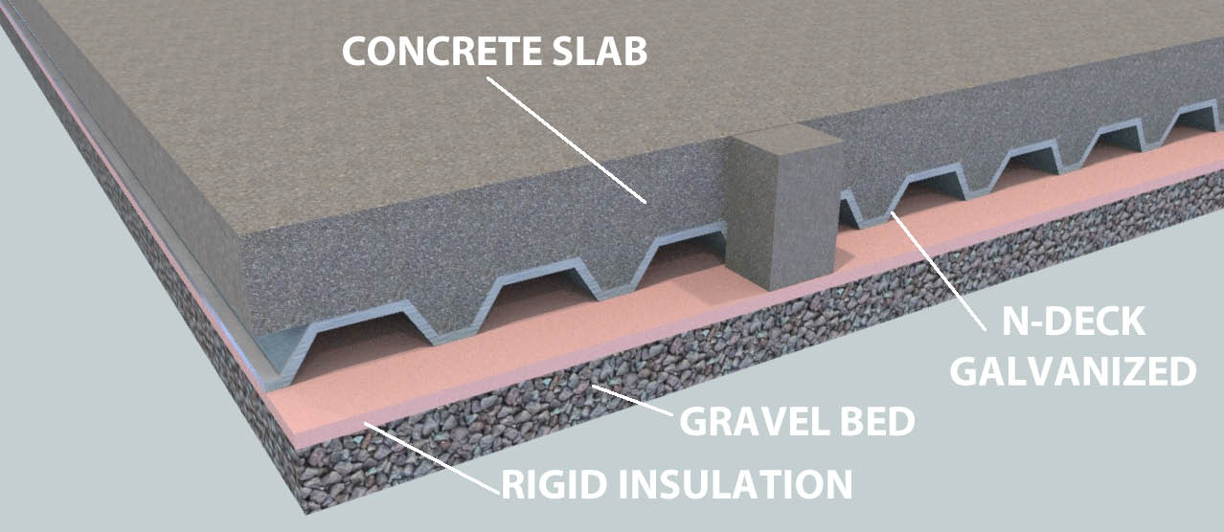
Alternate Slab Design
www.zonbak.com

Slide 29
Windows - Terms
U-value
Ability to conduct heat, typical value = 0.3, lower = better
R-value
Resistance to heat flow, inverse of U-value
Typical value = 3.3, higher = better
Increased by double glazing with insulating gasses, e.g., argon
Solar Heat Gain Coefficient (SHGC)
Fraction of solar heat that penetrates a window
SHGC of 0.8 lets in ~4 times more sunlight as 0.2
Lower SHGC → reduce cooling bills
Higher SHGC → reduce heating bills
Low e (e = emissivity)
Low emissivity windows reflect rather than transmit thermal radiation
Good for reducing air conditioning needs, bad for solar heating
Invisible metal coatings on glass lets visible light in
On outside – prevents radiation that heats house from entering
On inside – prevents radiant heat from escaping
Visible Light Transmittance
Percentage visible light penetrating
Infiltration
Ft³/minute air leakage per linear foot of crack around
Reducing infiltration reduces losses by convection
Notes:
Affordable Passive Solar Planbook for NC State Energy Office, N.C. Department of Administration, Appalachian State University Energy Center, Boone, North Carolina, June 2005
NFRC – the National Fenestration Rating Council, a national nonprofit organization that publishes a directory of windows that have been tested according to their criteria. The NFRC label lists the insulating values and air tightness which has been verified by independent laboratories. See figure 1-3.
R-value and U-value – ratings for the insulating values of windows. R-values refer to the resistance to heat flow. U-values measure the ability of the window to conduct heat and are the inverse of the R-value, thus the lower the U-value the better. A typical new window having a low-emissivity coating and an inert gas in the air space might have an R-value of 3.3, or a U-value of about 0.30.
Solar Heat Gain Coefficient (SHGC) – the fraction of solar heat that actually penetrates a window and enters the living area of a home. A window with a SHGC of 0.8 lets about 4 times as much sunlight into a home as a window with a SHGC of 0.2. Because they reduce summer cooling bills, windows with lower SHGC save money. However, for heating in passive solar homes, these same windows may not provide the savings in winter months of window units with a higher SHGC.
Shading Coefficient – this older method of showing the relative solar transmission through windows assigns a single clear window a Shading Coefficient of 1.0. Double-glazed windows have Shading Coefficients of 0.87. If you know the Shading Coefficient of a window, you can find the SHGC by multiplying the Shading Coefficient by 0.88.
Visible Light Transmittance – a measure of the percentage of visible light that penetrates a window.
Infiltration – the rated tightness of the window usually measured in cubic feet per minute of air leakage per linear foot of crack around the window unit. Double-hung units are typically the leakiest, while fixed are the tightest.
Low-emissivity windows (Wikipedia)
Emissivity is the value given to materials based on the ratio of heat emitted compared to a blackbody, on a scale from zero to one. A blackbody would have an emissivity of 1 and a perfect reflector would have a value of 0.
Window glass is by nature highly thermally emissive, as indicated in the table above. To improve thermal efficiency (insulation properties) thin film coatings are applied to the raw soda-lime glass. There are two primary methods in use: Pyrolytic CVD and Magnetron Sputtering.^{[2][3]} The first involves deposition of fluorinated tin oxide (SnO2:F see Tin dioxide uses) at high temperatures. Pyrolytic coatings are usually applied at the Float glass plant when the glass is manufactured. The second involves depositing thin silver layer(s) with antireflection layers.Magnetron sputtering uses large vacuum chambers with multiple deposition chambers depositing 5 to 10 or more layers in succession. Silver based films are environmentally unstable and must be enclosed in an Insulated glazing or Insulated Glass Unit (IGU) to maintain their properties over time. Specially designed coatings, are applied to one or more surfaces of insulated glass. These coatings reflect radiant infrared energy, thus tending to keep radiant heat on the same side of the glass from which it originated, while letting visible light pass. This results in more efficient windows because radiant heat originating from indoors in winter is reflected back inside, while infrared heat radiation from the sun during summer is reflected away, keeping it cooler inside.

Slide 30
Windows
Double-Glazed
Quality Construction
Good Weather stripping
South Side
High SHGC
Single Pane, high-emissivity, will need to use insulated shades to reduce heat loss at night

Slide 31
Different Types (Double Pane)
www.commercialwindows.org/vt.php
Notes:
http://www.commercialwindows.org/
Transmittance refers to the percentage of radiation that can pass through glazing. Transmittance can be defined for different types of light or energy, e.g., visible transmittance, UV transmittance, or total solar energy transmittance.
Transmission of visible light determines the effectiveness of a type of glass in providing daylight and a clear view through the window. For example, tinted glass has a lower visible transmittance than clear glass. While the human eye is sensitive to light at wavelengths from about 0.4 to 0.7 microns, its peak sensitivity is at 0.55, with lower sensitivity at the red and blue ends of the spectrum. This is referred to as the photopic sensitivity of the eye.
More than half of the sun's energy is invisible to the eye. Most reaches us as near-infrared with a few percent in the ultraviolet (UV) spectrum. Thus, total solar energy transmittance describes how the glazing responds to a much broader part of the spectrum and is more useful in characterizing the quantity of total solar energy transmitted by the glazing.
With the recent advances in glazing technology, manufacturers can control how glazing materials behave in these different areas of the spectrum. The basic properties of the substrate material (glass or plastic) can be altered, and coatings can be added to the surfaces of the substrates. For example, a window optimized for daylighting and for reducing overall solar heat gains should transmit an adequate amount of light in the visible portion of the spectrum, while excluding unnecessary heat gain from the near-infrared part of the electro-magnetic spectrum.

Slide 32
Solar Principles (cont.)
Do not Over-Glaze
Too much will
Overheat thermal mass during day
Lose too much heat during night
Do not over-size backup heat
Systems that cycle on and off often are inefficient
Exchange 2/3 air volume each hour
Do in controlled manner
Exterior connected fans in bathroom and kitchen
NOT leaks
Kachadorian, J (2006) “The Passive Solar House” Chelsea Green Publishing Company, White River Junction, VT.
Notes:
http://answers.yahoo.com/
Light energy and heat energy are the same thing, 'electromagnetic waves'. The fancy name for heat energy is infrared radiation and the fancy name for light energy is visible radiation. But they work the same. Heat and light come in tiny packets called photons that work like particles in some ways. They also act like waves, vibrating back and forth very fast. A photon is a unit, a whole package. There is no such thing as fast photons or slow photons. They are all going the same speed, the speed of light. So when photons hit something (like sunlight shining on your face) they can't slow down. They have to give up some of their energy in a different way. So they have to vibrate at a different rate of speed. They still move at the speed of light, they just vibrate slower while they move. So, the ONLY difference between heat and light is that they are vibrating at different rates of speed, even though they are travelling at the same rate of speed. Otherwise, they are just the same. Infrared (heat) photons vibrate slower than visible (light) photons. The light photons hit your face and are absorbed (swallowed up) by atoms. Their rate of vibration slows down and they change to heat photons. Your face feels warm. Then the heat photons leak out again as you cool off. Now, the Sun does put out a lot of both heat and light. Have you ever been in a car in the wintetime, with the sun shining in your face? The windows are transparent to light but not to heat. It is cold outside. Infrared waves (the photons) do not go through glass well. They are reflected outside. But the light comes through because the window is transparent to light, it lets the waves (phtotons) through. The light turns into heat when it hits your face, and you feel it. This is also what makes a car so hot in the summertime: the light of the sun comes in the car and changes to heat. Then it can't get out the windows again, and the car gets hot. So we do two things: we leave the windows open a little to let the air circulate and carry the heat back outside, and we put reflectors inside the windshield, to reflect the light back out, If the light is not absorbed, it is not being turned into heat. I hope this helps.

Slide 33
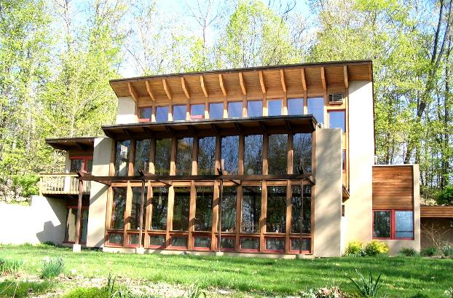
Over Glazed?
lunar.thegamez.net

Slide 34
Solar Principles (cont.)
Use conventional materials, in a new way
Most windows on South side
Concrete as floor of living space
Diverse styles and materials can be used
Kachadorian, J (2006) “The Passive Solar House” Chelsea Green Publishing Company, White River Junction, VT.
Notes:
http://answers.yahoo.com/
Light energy and heat energy are the same thing, 'electromagnetic waves'. The fancy name for heat energy is infrared radiation and the fancy name for light energy is visible radiation. But they work the same. Heat and light come in tiny packets called photons that work like particles in some ways. They also act like waves, vibrating back and forth very fast. A photon is a unit, a whole package. There is no such thing as fast photons or slow photons. They are all going the same speed, the speed of light. So when photons hit something (like sunlight shining on your face) they can't slow down. They have to give up some of their energy in a different way. So they have to vibrate at a different rate of speed. They still move at the speed of light, they just vibrate slower while they move. So, the ONLY difference between heat and light is that they are vibrating at different rates of speed, even though they are travelling at the same rate of speed. Otherwise, they are just the same. Infrared (heat) photons vibrate slower than visible (light) photons. The light photons hit your face and are absorbed (swallowed up) by atoms. Their rate of vibration slows down and they change to heat photons. Your face feels warm. Then the heat photons leak out again as you cool off. Now, the Sun does put out a lot of both heat and light. Have you ever been in a car in the wintetime, with the sun shining in your face? The windows are transparent to light but not to heat. It is cold outside. Infrared waves (the photons) do not go through glass well. They are reflected outside. But the light comes through because the window is transparent to light, it lets the waves (phtotons) through. The light turns into heat when it hits your face, and you feel it. This is also what makes a car so hot in the summertime: the light of the sun comes in the car and changes to heat. Then it can't get out the windows again, and the car gets hot. So we do two things: we leave the windows open a little to let the air circulate and carry the heat back outside, and we put reflectors inside the windshield, to reflect the light back out, If the light is not absorbed, it is not being turned into heat. I hope this helps.

Slide 35
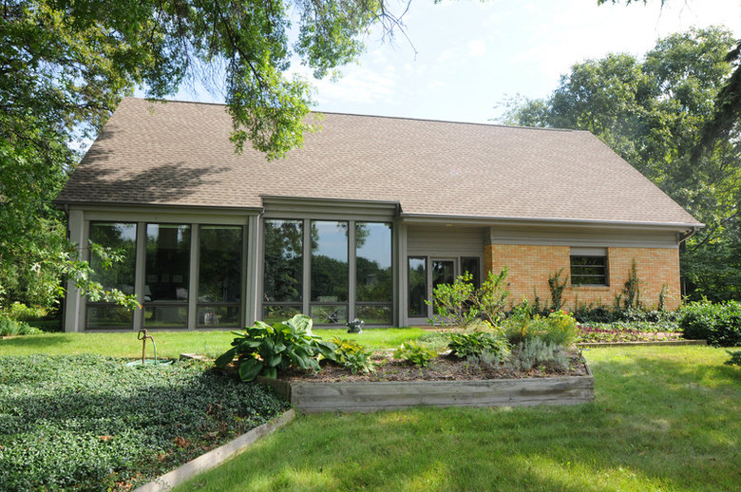
Passive Solar Home
www.seibertsmith.com

Slide 36
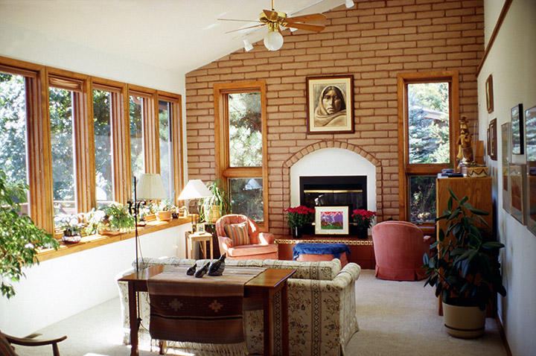
Passive Solar Home
1sun4all.com
Notes:
1sun4all.com

Slide 37
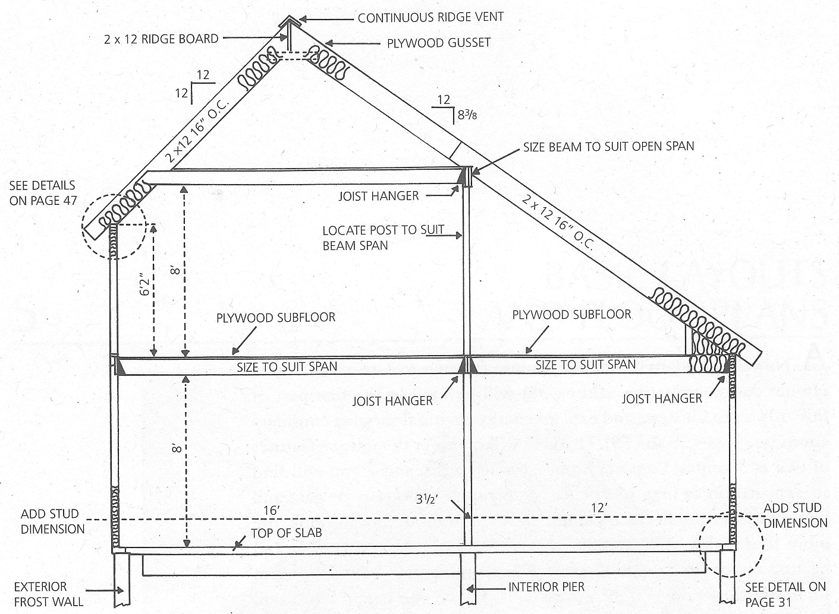
Example
Dimensions & U values
Heat loss through envelope
Window Insulation
Reheating
Heat load
Solar gain
Thermal slab
Saltbox 38
Hartford, Conn.
North Latitude: 41°5’

Slide 38
Dimensions & R values
Volume: 14,492 ft³
8’x28’x38’+19.67’x8’x38’
Wall Area, ft²
South: 570 (15’x38’)
North: 342 (9’x38’)
East & West: 493
9’x29’ + 0.5x29’x16’
TOTAL: 1,898
R: 21.36
U: 0.0468 BTU/hr/ft²/°F
Roof: 1,520 ft2 (38’x40’)
R: 32.61
U: 0.0307 BTU/hr/ft²/°F
Window Area, ft²
South: 162
North: 10
East: 64
West: 35
TOTAL: 271
R: 1.92
U: 0.5208 BTU/hr/ft²/°F
Kachadorian, J (2006) “The Passive Solar House” Chelsea Green Publishing Company, White River Junction, VT.

Slide 39
Heat loss through envelope
E = A U
E = heat loss through envelope, BTU/hr/°F
A = Area, ft²
U = Heat conductance, BTU/hr/ft²/°F
Kachadorian, J (2006) “The Passive Solar House” Chelsea Green Publishing Company, White River Junction, VT.

Slide 40
Window Insulation
203 ft² of thermo-shutters
Closed 16 hr/d during heating season
R: 11.33, U: 0.0883 BTU/hr/ft²/°F
Kachadorian, J (2006) “The Passive Solar House” Chelsea Green Publishing Company, White River Junction, VT.

Slide 41
Reheating Fresh Air
Assume 2/3 of home air changed/hr
Window & door cracks
Opening & closing doors
Fans (bathrooms & kitchen)
I = V H Q
I = Infiltration heat loss, BTU/hr/°F
V = House volume, ft³
H = Energy to raise 1 ft³ air 1°F = 0.018 BTU/ft³/°F
Q = Air change rate (changes/hr)
Kachadorian, J (2006) “The Passive Solar House” Chelsea Green Publishing Company, White River Junction, VT.

Slide 42
Heat Load (w/Window Insulation)
L = (E + I) D
L = Heat Load, BTU
D = (Heating) Degree Days, °F⋅d
Difference of median outdoor temp & 65°F over 24 hrs
Assumes house kept @ 72°F & 7°F provided by waste heat from appliances, lights, people, etc.
Tables provided by NOAA, Power companies, ASHRAE, www.degreedays.net, …
Kachadorian, J (2006) “The Passive Solar House” Chelsea Green Publishing Company, White River Junction, VT.
Notes:
American Society of Heating, Refrigerating and Air Conditioning Engineers

Slide 43
Solar Gain
G = SHGF SHGC T S A
G = Heat gain, BTU/d/°F
SHGF = Solar heat gain factor, BTU/ft²/d
Amount of energy from the sun
ASHRAE Tables for various latitudes, available on web
SHGC = Solar heat gain coefficient, unitless
Fraction of sun energy thru window (color, coatings, dividers)
We will assume a value of 0.88 (pretty high)
Can get from window manufacturer
T = Time, d
S = Fraction of sunshine, unitless
Fraction of daylight hours without clouds
Available on web
Hartford Conn., February: 0.55
A = Area of glazing, ft²
Kachadorian, J (2006) “The Passive Solar House” Chelsea Green Publishing Company, White River Junction, VT.
Notes:
American Society of Heating, Refrigerating and Air Conditioning Engineers
SHGC replaces SC (Shading coefficient). SHGC is for entire window, while SC was for the glass, so SHGC takes into account dividers, frame, etc. SHGC =~0.87 SC

Slide 44
Solar Heat Gain Factor, BTU/ft²/hr
Half day totals – February @ N 40° Latitude
East – read East column down (morning)
West: read East Colum up (afternoon)
South: Read table down and up (all-day, double)
Morning | East (West) | South | Afternoon
0700 | 51 | 14 | 1700
0800 | 183 | 94 | 1600
0900 | 186 | 157 | 1500
1000 | 143 | 203 | 1400
1100 | 71 | 231 | 1300
1200 | 25 | 241 | 1200
Half Day Total | 648 | 821 | Half Day Total
Kachadorian, J (2006) “The Passive Solar House” Chelsea Green Publishing Company, White River Junction, VT.
Notes:
Ignore east in afternoon, west in morning
East column does NOT say (West) in typical table.

Slide 45
Solar Gain Estimate, Feb.
East
South
West
Kachadorian, J (2006) “The Passive Solar House” Chelsea Green Publishing Company, White River Junction, VT.
Notes:
American Society of Heating, Refrigerating and Air Conditioning Engineers
28 d in Feb

Slide 46
Percent of Heat from Sun
February performance
Total heat load = 9.51 MBTU
Solar gain = 4.47 MBTU
4.47 MBTU / 9.51 MBTU = 0.47
47 % of heat is from sun
Over 9 month heating season
~54 % of heat can be provided by sun
Assumes house heated to 72°F day and night
House can drop to ~60°F @ night: reduce furnace use
Kachadorian, J (2006) “The Passive Solar House” Chelsea Green Publishing Company, White River Junction, VT.
Notes:
American Society of Heating, Refrigerating and Air Conditioning Engineers

Slide 47
Thermal Mass
Can thermal mass maintain house temperature @ ~60°F during February night?
Solar Slab: 4” concrete on 12” concrete block
V = T’ A
V = Volume of concrete, ft³
T’ = Effective thickness = Slab + 0.5⋅Block
A = Foundation Area, ft²
Kachadorian, J (2006) “The Passive Solar House” Chelsea Green Publishing Company, White River Junction, VT.

Slide 48
Thermal Mass
SSTC = V H_{c}
SSTC = Solar Slab Thermal Capacity, BTU/°F
H_{c} = Heat storage capacity of concrete, BTU/ft³/°F
30 BTU/ft³/°F
Assume:
Outside night temperature:
House & solar slab: 68°F @ 10 PM to 60°F @ 7 AM
Elapsed time = 9 hr
Average house night time temperature:
Difference between inside & out:
Kachadorian, J (2006) “The Passive Solar House” Chelsea Green Publishing Company, White River Junction, VT.

Slide 49
Thermal Mass
Night time heat loss
Heat loss through envelope:
Heat loss for air reheating:
Total:
Slab needs to provide this many BTUs, can it?
Resulting Change in Solar Slab temperature:
Kachadorian, J (2006) “The Passive Solar House” Chelsea Green Publishing Company, White River Junction, VT.

Slide 50
Passive Solar Summary
Orientation & site selection
Long side w/in 15º of true south (max winter solar gain; min summer heat)
Should have - Direct sun 9 am - 3 pm December 21
Increased south-facing glass – Sun warms in winter
South facing glazing = 7-12% of the floor area
Thermal mass required to temper heat gain
Less east and west glass
reduce summer cooling needs
Energy efficiency
Insulated, air-tight, and efficient HVAC
Thermal storage
store heat & regulate interior temperatures winter and summer
Window shading (external and internal)
Reduce summer heat gain & glare; trap heat at night
Moisture control
Durability, indoor air quality, and comfort
Room layout
Sunlit and sun-warmed when room is needed
Notes:
Affordable Passive Solar Planbook for NC State Energy Office, N.C. Department of Administration, Appalachian State University Energy Center, Boone, North Carolina, June 2005
Increased south-facing glass area - allows sunlight to help warm the home in winter months. South-facing windows receive close to three times as much sunlight as east and west windows in the winter and a third less sunlight in the summer. Sun-tempered homes have no more than 7% of the floor area as southern glazing. In passive solar homes the area of the south facing glazing is 7-12% of the floor area. This amount of glazing requires the use of thermal mass to temper the heat gain. A home with increased southern glazing up to 7% is considered sun-tempered and can be effective with out the use of thermal mass.
Lower east and west glass areas - reduce summer cooling needs because it prevents unwanted sun from entering the home in the morning and afternoon. Eliminating the windows also lowers construction costs.
Orientation and site selection - are critical in passive solar design. The passive solar windows must face within 15º of due south to maximize solar gain in winter and minimize overheating in summer. Be aware that magnetic south is different than true south. To find how many degrees they vary at your site visit www.ngdc.noaa.gov/seg/geomag/jsp/Declination.jsp. The house should be designed on an east-west axis so the long side faces south. Trees on the site reduce summer cooling bills, but should not shade south-facing windows in winter. Effective passive solar design is not possible on all sites due to the fact that the site must receive direct sunlight on December 21st between 9 am and 3 pm. Privacy is also a factor, so if the south side is exposed to the street or neighboring houses it may not be conducive to passive solar design.
Energy efficient design - the first step in a successful passive solar home includes proper installation of recommended levels of insulation, air-tight design, and efficient heating and cooling systems. The key energy efficiency steps start on page 13.
Thermal storage mass - materials such as concrete floors, interior brick walls, brick pavers, and tile store heat and regulate interior temperatures both in winter and summer.
Effective window shading - reduces summer cooling needs and glare. Window shades lowered at night can also be used to help trap the heat absorbed by the thermal mass.
Moisture control systems - increases the home’s durability, improve indoor air quality, and provide comfort in both summer and winter.
Plan the room layout - to take advantage of the sun’s path. Rooms should match solar gain to the time of day the room is used. More on design guidelines on page 5.

